Slide 1
Section 1.1: Paths and Models
Math for Liberal Studies

Slide 2
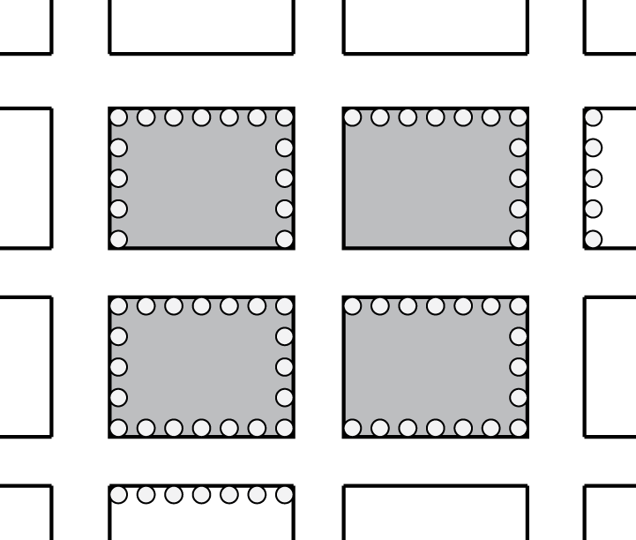
Parking Meters
Here is a map of the parking meters in a small neighborhood
Our goal is to start at an intersection, check the meters, and return to our starting point…
…without retracing our steps!

Slide 3
Solution Attempt #1

Slide 4
Solution Attempt #1

Slide 5
Solution Attempt #1

Slide 6
Solution Attempt #1

Slide 7
Solution Attempt #1

Slide 8
Solution Attempt #1

Slide 9
Solution Attempt #1

Slide 10
Solution Attempt #1

Slide 11
Solution Attempt #1

Slide 12
Solution Attempt #1
Now we’re stuck, so we know this can’t be a solution to the problem!

Slide 13
Solution Attempt #2
Let’s try again, this time with a different starting point…

Slide 14
Solution Attempt #2

Slide 15
Solution Attempt #2

Slide 16
Solution Attempt #2

Slide 17
Solution Attempt #2

Slide 18
Solution Attempt #2
Notice that it’s OK for us to return to the start since there is still a way to leave this spot without retracing our steps.

Slide 19
Solution Attempt #2

Slide 20
Solution Attempt #2

Slide 21
Solution Attempt #2

Slide 22
Solution Attempt #2

Slide 23
Solution Attempt #2

Slide 24
Solution Attempt #2

Slide 25
Solution Attempt #2
Notice how we just went back the way we came. This is not a “retrace” because there are meters on both sides of the street.

Slide 26
Solution Attempt #2

Slide 27
Solution Attempt #2

Slide 28
Solution Attempt #2

Slide 29
Solution Attempt #2
And we’re stuck again, so we know this can’t be a solution to the problem either!

Slide 30
You Try It
We haven’t had any luck so far… now it’s your turn to give it a try
Can you choose a starting point, visit all the parking meters, and return to the start without retracing?

Slide 31
Now What?
We could continue to use trial and error to see if we can find a solution
We might eventually become convinced that there is no solution
We’re going to use a model to represent this problem to make it easier to study

Slide 32
Models and Math
A model is a mathematical tool that simplifies a problem, but keeps all of the important information
For example, if you ever had to read a word problem and create an equation that you used to solve it, then you have created a mathematical model

Slide 33
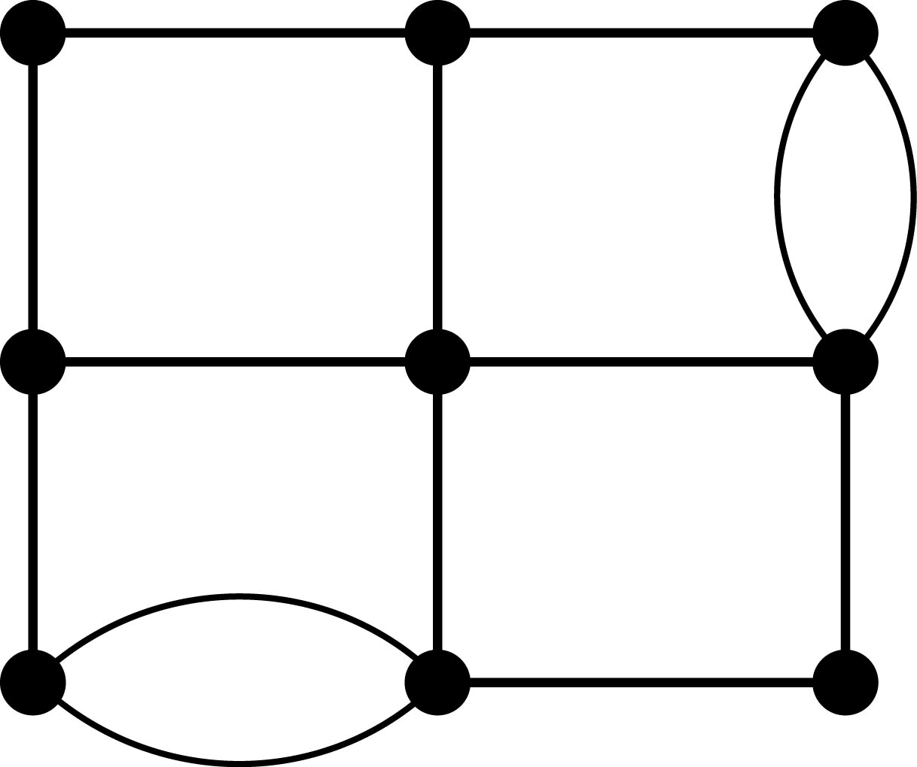
Our Model: A “Graph”
In our model, we will represent each intersection by a big black dot called a “vertex”
Each row of parking meters is connected by a line called an “edge”

Slide 34
Graph
vertices
edges
vertex

Slide 35
Using the Graph
The graph contains all of the information we need to solve our parking meter problem
We don’t need to know the names of the streets or how long they are
All we need to know is which streets have parking meters, and how they intersect each other

Slide 36
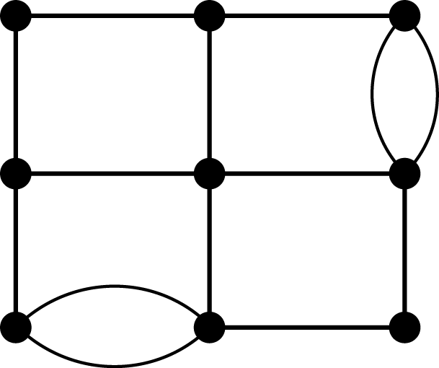
Two Paths: Map vs. Graph

Slide 37
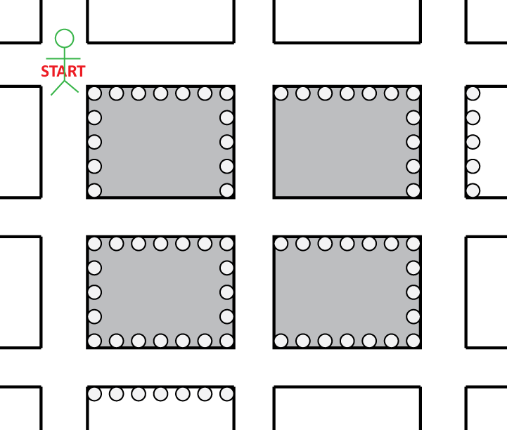
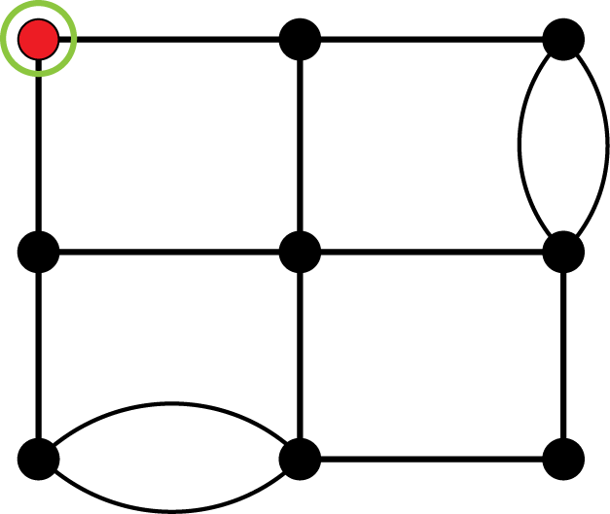
Two Paths: Map vs. Graph

Slide 38
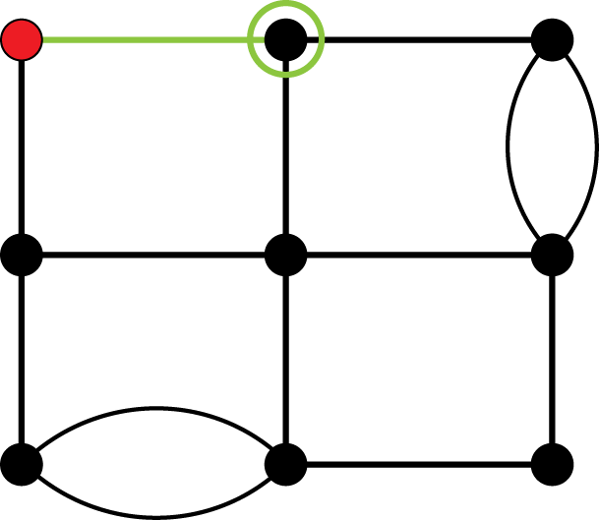
Two Paths: Map vs. Graph

Slide 39
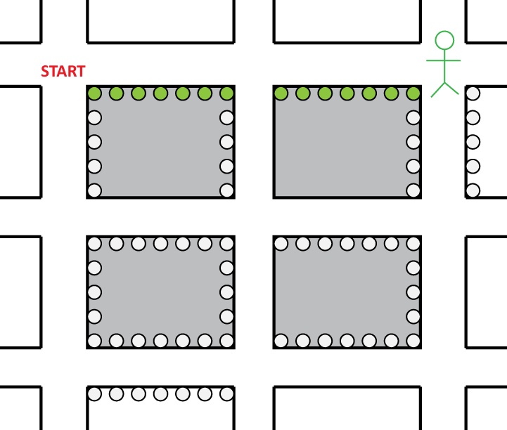
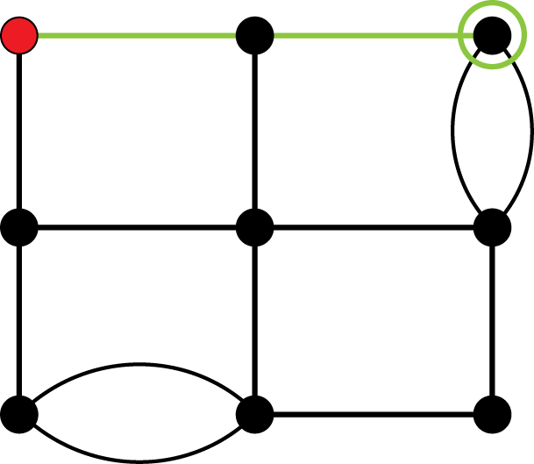
Two Paths: Map vs. Graph

Slide 40
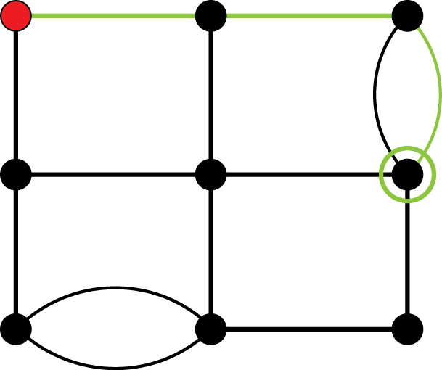
Two Paths: Map vs. Graph

Slide 41
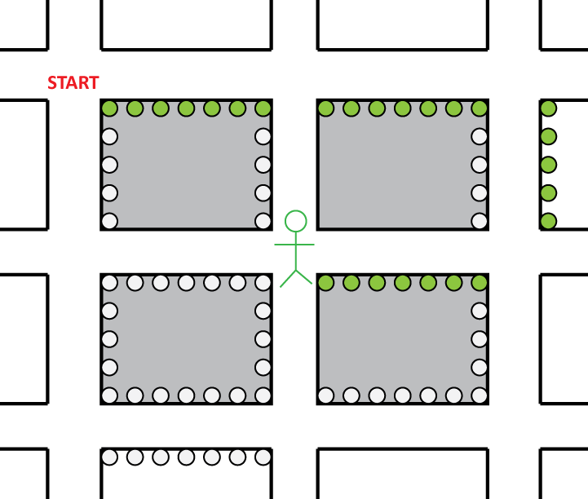
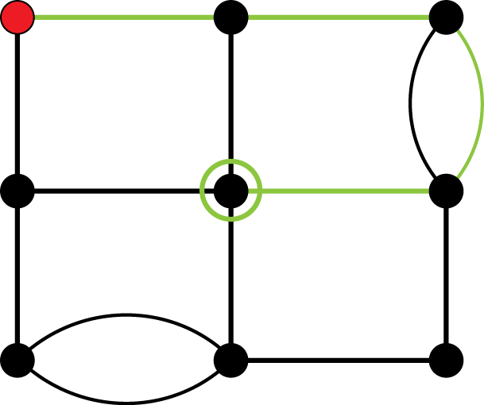
Two Paths: Map vs. Graph

Slide 42
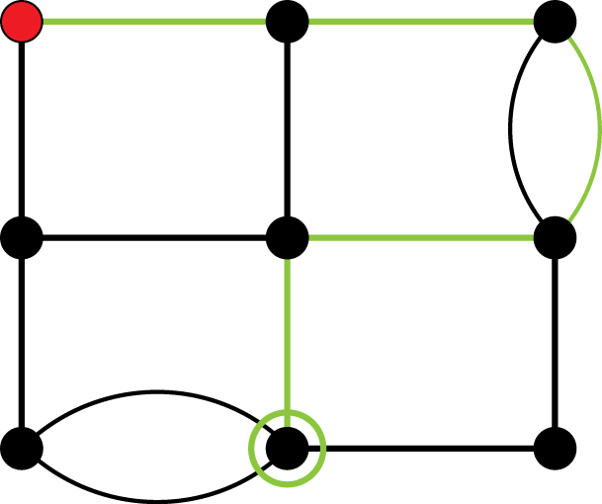
Two Paths: Map vs. Graph

Slide 43
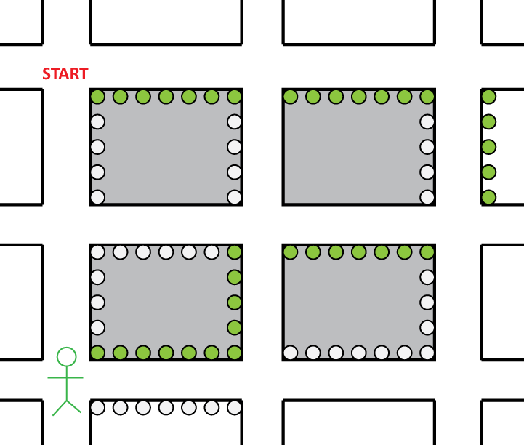
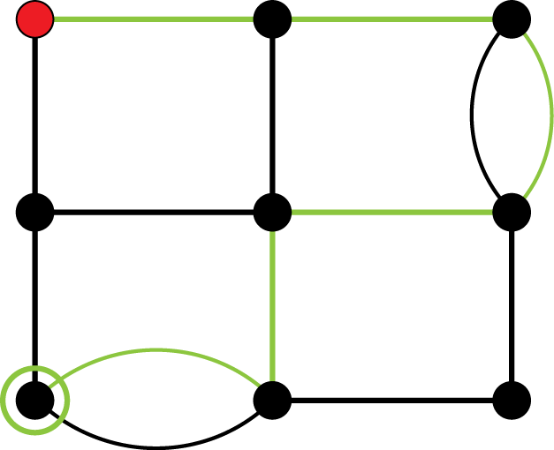
Two Paths: Map vs. Graph

Slide 44
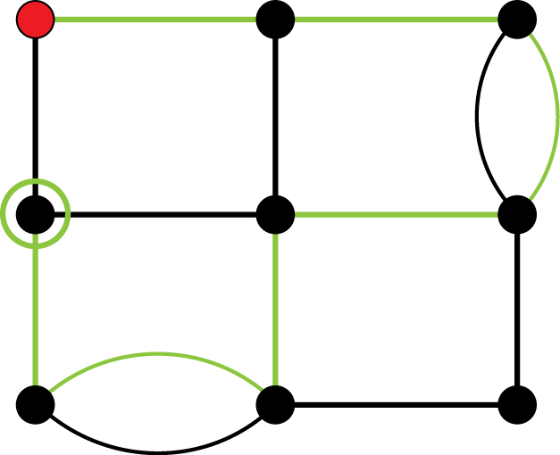
Two Paths: Map vs. Graph

Slide 45
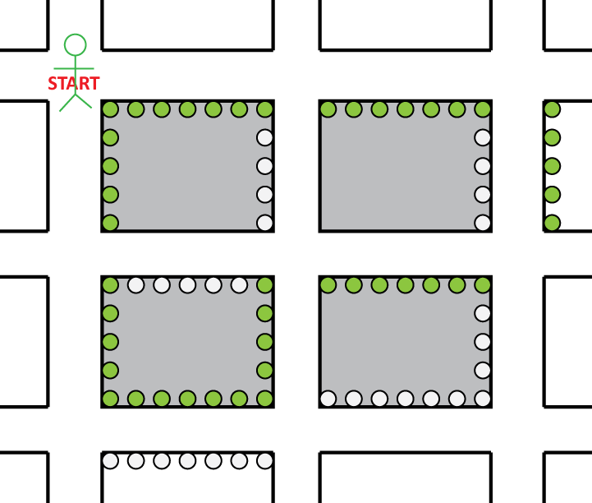
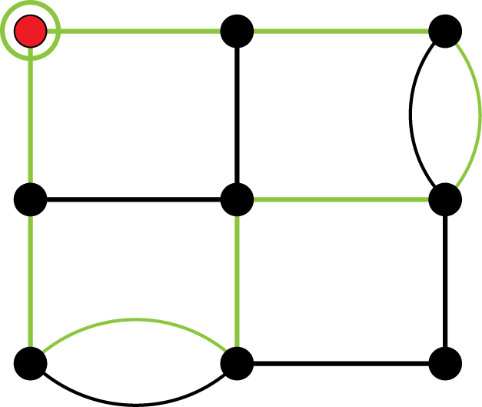
Two Paths: Map vs. Graph

Slide 46
From Now On: Graphs Only
From now on, we will only use graphs to study these kinds of problems
We will eventually learn how to tell which graphs have solutions to the parking meter problem and which do not
For now, we’ll establish some vocabulary and practice creating graphs

Slide 47
Definitions
A path is a sequence of vertices that are connected by edges. A path can repeat the same edge or vertex multiple times, and doesn’t have to end at the same place it begins.
A circuit is a path that ends at the same place it begins.

Slide 48
Definitions
An Euler circuit is a circuit that includes every edge of the graph exactly once.
This Euler circuit (pronounced “oiler”) is exactly what we are looking for in our parking meter problem
It turns out there are many other kinds of problems for which we want Euler circuits

Slide 49
Applications of Euler circuits
checking parking meters
street cleaning
snow plowing
mail delivery
garbage collection
bridge inspection
etc.

Slide 50
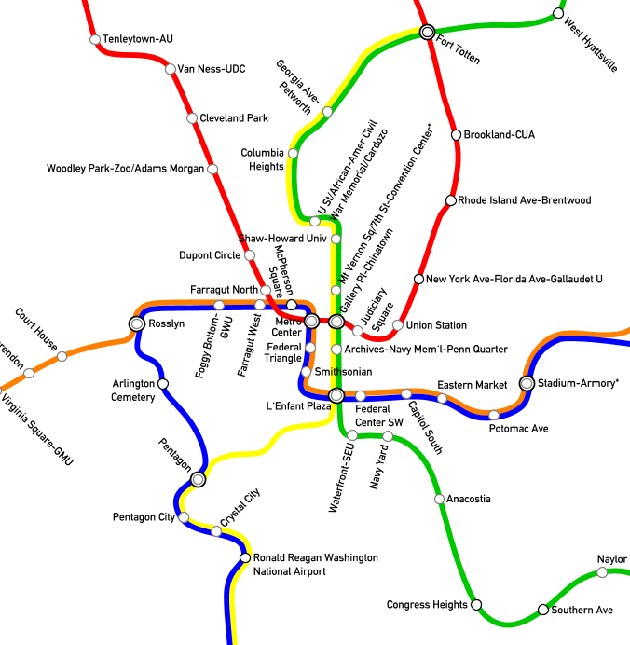
Applications of Euler Circuits
Here is a map of a portion of the DC Metro system
This map already looks like a graph

Slide 51
Applications of Euler Circuits
Each station is a vertex
The connections between stations are edges

Slide 52
Applications of Euler Circuits
A maintenance worker might need to inspect every tunnel in the system and return to his/her starting point and minimize retracing

Slide 53
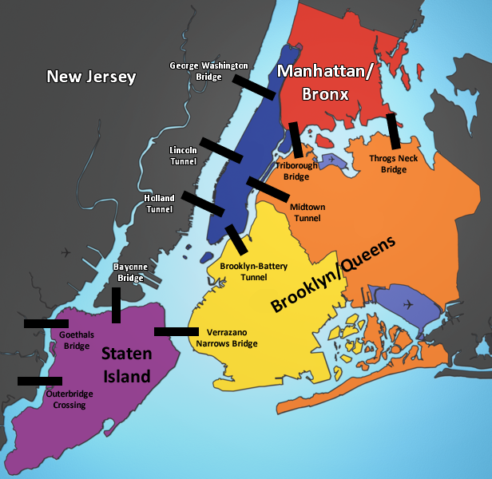
Applications of Euler Circuits
Here is a map of some of the bridges in New York City

Slide 54
Applications of Euler Circuits
We can represent this system with a graph
Each bridge is represented by an edge
Each location is represented by a vertex

Slide 55
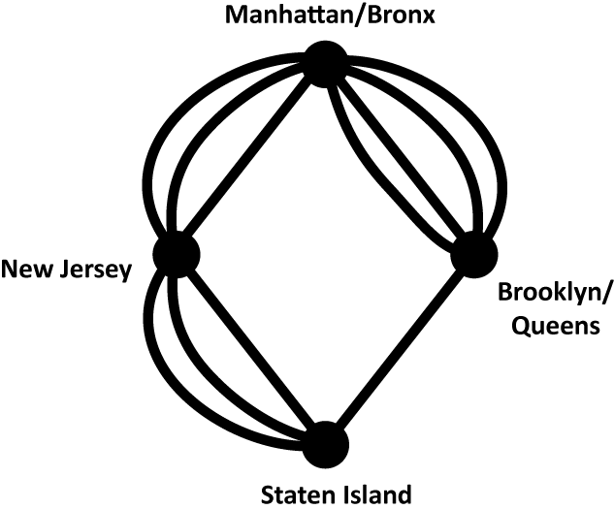
Applications of Euler Circuits
The graph on the left represents the map on the right.

Slide 56
Applications of Euler Circuits
Using this graph, we can more easily solve problems that involve traveling over these bridges
For example, a bridge inspector might want to find an Euler circuit for this graph

Slide 57
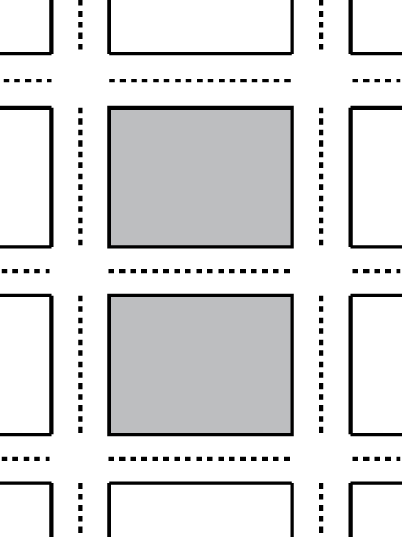
Applications of Euler Circuits
Now consider this map of a small neighborhood
Suppose it is your job to drive a snow plow and clean the streets of this neighborhood after a snowstorm

Slide 58
Applications of Euler Circuits
You want to make sure to plow every lane (notice each street has 2 lanes, so you’ll have to drive down each road twice)
You don’t want to retrace your steps unless you have to
You want to return to your starting point

Slide 59
Applications of Euler Circuits
Let’s draw the graph for this problem
Each intersection will be represented by a vertex
Each lane will be represented by an edge

Slide 60
Applications of Euler Circuits

Slide 61
Applications of Euler Circuits
Can you solve the problem?
Pick a starting point and try to find an Euler circuit for this graph

Slide 62
Applications of Euler Circuits
Can you solve the problem?
Pick a starting point and try to find an Euler circuit for this graph
It turns out we can find an Euler circuit for this graph (there are lots!)

Slide 63
Looking Ahead
Is there a way to know ahead of time which graphs have Euler circuits and which don’t?
We will discuss that question in the next section!

